Slide 1
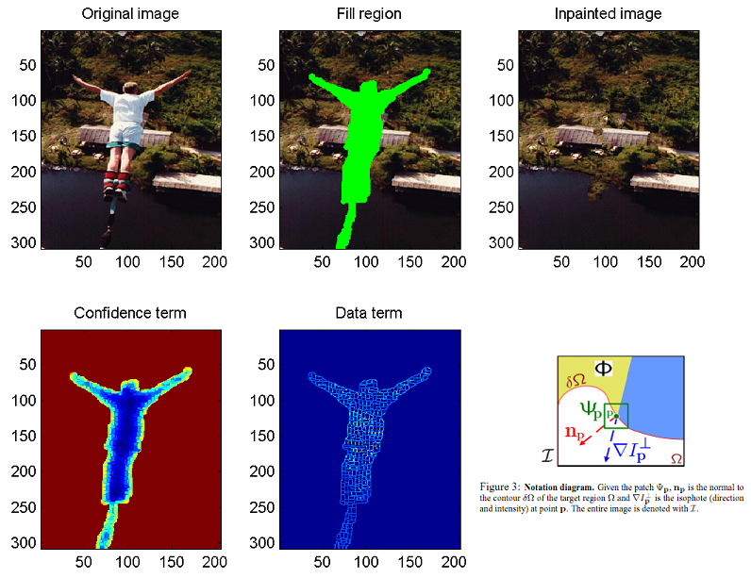
Object Removal by Exemplar-based Inpainting --- Sooraj Bhat

